Slide 1

Deepfake Detection : Image, Audio, Video
Presented By : 1. Aditya Chavan Exam No. B400360548
2. Varad Dixit Exam No. B400360575
3. Saidutt Bhagat Exam No. B400360517
4. Pranav Dumbre Exam No. B400360580

Slide 2
Agenda
INTRODUCTION
MOTIVATION OF OUR PROJECT
LITERATURE SURVEY
GAP ANALYSIS
PROBLEM STATEMENT
OBJECTIVES
SYSTEM ARCHITECTURE
MATHEMATICAL MODEL
PROPOSED ALGORITHM
SDLC MODEL
SEQUENCE DIAGRAM, USE CASE DIAGRAM
SYSTEM REQUIREMENTS
SCREENSHOTS
ADVANTAGES, LIMITATIONS
CONCLUSION
FUTURE SCOPE
LIST OF PUBLICATIONS
REFERENCES

Slide 3
Introduction
When someone uses advanced computer algorithms to swap faces, alter expressions, or insert people into scenes where they never were, we call them a deepfake. These deepfakes can look so real that it’s almost impossible to tell they’ve been tampered with.
Deepfakes have grown more convincing over time. People can use them to spread false news, harm someone’s reputation, or even steal someone’s identity. Left unchecked, these fake images can cause real damage both to individuals and to society’s trust in what we see online.
To fight back, we need detection tools that are just as powerful as the methods used to create deepfakes. That’s where deep neural networks come in. By teaching a neural network on thousands of examples of both real and fake images, we can train it to spot the tiny clues—things like inconsistent lighting, odd textures, or unusual pixel patterns—that give a deepfake away.

Slide 4
MOTIVATION OF OUR PROJECT
Rise in Deepfake Threats : Deepfakes are being increasingly used for spreading misinformation, cyber fraud, identity manipulation, and political propaganda.
Lack of Awareness in General Public : Many individuals cannot distinguish between real and synthetic media, making them vulnerable to manipulation.
Real-Time Harm Potential : Deepfakes can damage reputations, incite violence, or impersonate voices and faces in real-time communication platforms.
Multimodal Deepfake Detection Is Underexplored : Most research focuses on either images or videos alone. There is limited work on unified systems that handle image, audio, and video simultaneously.

Slide 5
LITERATURE SURVEY
Effective and Fast Deep-fake Detection Method Based on Haar Wavelet Transform [1]
This paper uses Haar Wavelet Transform to detect blur differences between fake faces and backgrounds, focusing on sharpness variations. It's a quick method for identifying inconsistencies in deepfake videos.
2
3
4
5
6
7
8
9
10

Slide 6
LITERATURE SURVEY
FaceForensics++: Learning to Detect Manipulated Facial Images [2]
This study uses neural networks to spot altered facial images, analyzing various artifacts. By training on a large dataset, it aims to improve detection accuracy for manipulated faces in videos and images.
1
3
4
5
6
7
8
9
10

Slide 7
LITERATURE SURVEY
FSBI: Deepfakes Detection with Frequency Enhanced Self-Blended Images
[3] The paper blends images to create fake artifacts and uses frequency analysis (Wavelet Transforms) to spot these artifacts, improving deepfake detection, especially in videos and images with subtle manipulations.
1
2
4
5
6
7
8
9
10

Slide 8
LITERATURE SURVEY
Comparative Analysis of Deepfake Image Detection Method Using Convolutional Neural Networks [4]
This paper compares different CNN models to detect deepfake images. It evaluates their accuracy and precision, helping to find the most effective neural network for detecting fakes across multiple datasets.
1
2
3
5
6
7
8
9
10

Slide 9
LITERATURE SURVEY
Deepfake Detection Using Deep Learning Methods: A Systematic and Comprehensive Review [5]
This review summarizes various deep learning methods for deepfake detection, comparing how well different models perform using metrics like accuracy and recall, and exploring challenges in detection.
1
2
3
4
6
7
8
9
10

Slide 10
LITERATURE SURVEY
Detection of Fake Images via the Ensemble of Deep Representations from Multi Color Spaces [7]
The paper combines data from multiple color spaces (like RGB and others) to enhance fake image detection. This approach improves accuracy by capturing different features that are hard to spot using just one color model.
1
2
3
4
5
7
8
9
10

Slide 11
LITERATURE SURVEY
Cross-Forgery Analysis of Vision Transformers and CNNs for Deepfake Image Detection [7]
This paper compares Vision Transformers and CNNs, showing that Vision Transformers are better at adapting to new deepfake techniques. It highlights how each method performs with deepfake images.
1
2
3
4
5
6
8
9
10

Slide 12
LITERATURE SURVEY
Explaining Deepfake Detection by Analyzing Image Matching [8]
This paper focuses on detecting deepfakes by analyzing how images match. It introduces a method called FST-Matching (Forgery-Sensitive Template Matching) to improve the detection of artifacts and tests various deep learning models for performance. FST-Matching enhances artifact detection by comparing image features to detect discrepancies that are often overlooked in traditional methods.
1
2
3
4
5
6
7
9
10

Slide 13
LITERATURE SURVEY
Deepfake Detection Using Multi-Scale and Multimodal Transformers
[9] This method uses transformers that look at deepfakes from different scales and perspectives, capturing more subtle cues across video and image data. It helps detect fakes that may not be visible at one resolution.
1
2
3
4
5
6
7
8
10

Slide 14
LITERATURE SURVEY
Deepfakes Generation and Detection: State-of-the-art, Open Challenges, Countermeasures, and Way Forward [10]
This paper reviews deepfake detection methods, offering insights into current challenges and future research. It discusses various techniques and datasets, providing benchmarks for evaluating model performance.
1
2
3
4
5
6
7
8
9

Slide 15
Gap Analysis
GAP ANALYSIS | ACCURACY | WHAT IT DETECTS | WEAKNESS OF THE MODEL
Effective and Fast Deep-fake Detection Method Based on Haar Wavelet Transform [1] | Moderate | Video | Limited to blur detection; may not handle advanced or subtle manipulations.
FaceForensics++: Learning to Detect Manipulated Facial Images [2] | High (85-95%) | Image | May not generalize well to new manipulation techniques.
FSBI: Deepfakes Detection with Frequency Enhanced Self-Blended Images [3] | N/A | Video | Struggles with low-frequency artifacts and high-quality videos
Comparative Analysis of Deepfake Image Detection Method Using Convolutional Neural Network [4] | N/A | Image | Computationally expensive, limited to image detection.

Slide 16
Gap Analysis
GAP ANALYSIS | ACCURACY | WHAT IT DETECTS | WEAKNESS OF THE MODEL
Deepfake Detection Using Deep Learning Methods: A Systematic and Comprehensive Review [5] | N/A | N/A | No novel solutions; focuses on reviewing existing methods.
Detection of Fake Images via the Ensemble of Deep Representations from Multi Color Spaces [6] | N/A | Image | Limited to images, not effective for video deepfakes.
Cross-Forgery Analysis of Vision Transformers and CNNs for Deepfake Image Detection [7] | N/A | Image | Requires large training data and computational resources.
Explaining Deepfake Detection by Analyzing Image Matching [8] | Moderate | Video | Less effective with low-quality or dynamic video content.

Slide 17
Gap Analysis
GAP ANALYSIS | ACCURACY | WHAT IT DETECTS | WEAKNESS OF THE MODEL
Deepfakes Generation and Detection: State-of-the-art, Open Challenges, Countermeasures, and Way Forward [9] | N/A | Video | Struggles with low-resolution videos.
Deepfake Detection Using Deep Learning Methods: A Systematic and Comprehensive Review [10] | N/A | N/A | Lacks practical detection methods, focuses on existing research.

Slide 18
PROBLEM STATEMENT
To design and implement a system that utilizes deep learning techniques to detect and prevent deepfake content across images, audio, and video formats, aiming to improve detection accuracy and reduce false positives, thereby strengthening digital media trust and security.
Development of an efficient system which will be able to identify deepfake media of all spectrums i.e image, audio, & video.

Slide 19
OBJECTIVES
To design and implement a system that utilizes deep learning techniques to detect and prevent deepfake content across images, audio, and video formats, aiming to improve detection accuracy and reduce false positives, thereby strengthening digital media trust and security.
Development of an efficient system which will be able to identify deepfake media of all spectrums i.e image, audio, & video accurately and display it to the user on the UI itself.
UI must be easy to use and understand to non tech users too they must be able to upload the files without any difficulty or any compatibility issues.

Slide 20
SYSTEM ARCHITECTURE
1.Input Layer : This layer is responsible for taking the inputs from the user. This is done via PyQT5 based UI which enables user to upload the desired media in order for algorithm to test it.
2.Preprocessing : This layer is responsible for preprocessing the data. The uploaded media will not always be cleaned or processed, it can be in many forms it might need some resizing (image), noise clearing (audio), feature enhancement (video).This layer ensures that the data uploaded is preprocessed efficiently.
3.Feature Extraction :This layer is responsible for analyzing the input media (image, audio, or video) and identifying important patterns or characteristics. It uses deep learning models such as CNNs, RNNs, or Transformers to extract meaningful features like textures, facial landmarks, voice frequencies, or motion patterns. These extracted features are then passed to the classification model to help determine whether the content is real or fake.

Slide 21
SYSTEM ARCHITECTURE
4.Classification Module : This is the core component of the deepfake detection system that performs the final decision-making. It uses a trained machine learning model to analyze the extracted features from the input media (image, audio, or video) and determines whether the content is real or fake. The classification model outputs a probability score based on the patterns it has learned during training. 5. Output Layer : This is the final layer of system. It is responsible to display the output to the user based on the probability score which is calculated by classification module. If the probability score is higher for real media the output will be displayed as the “real” else it will be displayed as fake.

Slide 22
MATHEMATICAL MODEL
Image Module
Finds lines and shapes: Looks for edges and patterns in pictures.
Makes odd spots pop out: Boosts any strange or blurry areas that might be fake.
Turns picture into numbers: Converts what it finds into a list of values for the next step.
Audio Module
Grabs main sound features: Picks out simple voice traits like tone and pitch.
Combines over the whole clip: Adds up these traits so tiny noises cancel out.
Spots unusual voices: Uses those summed traits to notice if a voice sounds “off.”
Video Module
Checks each frame: Treats every frame like a picture and runs the image checks.
Smooths the verdict: Averages all frame scores so one odd frame won’t spoil it.
Watches for jumps: Looks for sudden changes between frames that real videos don’t have.

Slide 23
PROPOSED ALGORITHM
Load Media : User selects an image, audio clip, or video file.
Preprocess :
Image: Resize and convert to grayscale.
Audio: Convert to mono, trim silence.
Video: Extract individual frames from the clip.
3. Extract Features : Image Frames: Apply a bank of Gabor filters,for each pixel, take the highest filter response to highlight edges/ textures. Flatten the filtered image into a single list of numbers. Audio Clip : Compute MFCCs (Mel-Frequency Cepstral Coefficients) on short overlapping windows. Sum each MFCC coefficient across all windows to get one feature list. Video : For each extracted frame, perform the Image Frames steps to get a feature list per frame.Collect all frame feature lists together.

Slide 24
PROPOSED SYSTEM
4. Compare to all known examples :
The system takes the new feature list (from an image, audio clip, or each video frame) and searches its “memory” of known real and fake examples.
It computes a simple distance score to find the single best match.
5. Decide if the media is real or fake :
If that closest example is labeled “real,” the system calls the input real; otherwise it calls it fake.
For video, it repeats this for every frame, then uses a majority vote (or average score) so that one odd frame won’t overturn the final decision.
6. Display the result :
The GUI then displays “REAL” or “FAKE” along with the distance-based confidence (smaller distance → higher confidence).
This gives the user a clear, immediate result and an idea of how sure the system is.

Slide 25
SDLC MODEL
Model Used: Agile
Agile is flexible and fast software development model where the project is built in small parts called “sprints”.
Agile helps improvement of the system step by step without needing to start over each time a change is needed.
Why did we use Agile methodology ?
Step by step development, easier to add changes
Works faster without having to start over each time a change is needed.

Slide 26
AGILE MODEL PHASES
Requirement Analysis : Decide what the system should do: detect fake images, audio, and video.List tools, datasets, and basic needs (GUI, accuracy, speed).
Planning and design : Break the whole project into small tasks called “sprints”.
Development (Sprint-wise): Start coding each module in small parts for each and every feature such as image, audio, and video.
Testing : Test the module after each after sprint. Fix bugs or improve based on the feedback.
Integration : Combine all the modules into a single working system. Ensure that everything works well together.
Deployment : Run the final version and add updates or fix issues in future sprints if needed.

Slide 27
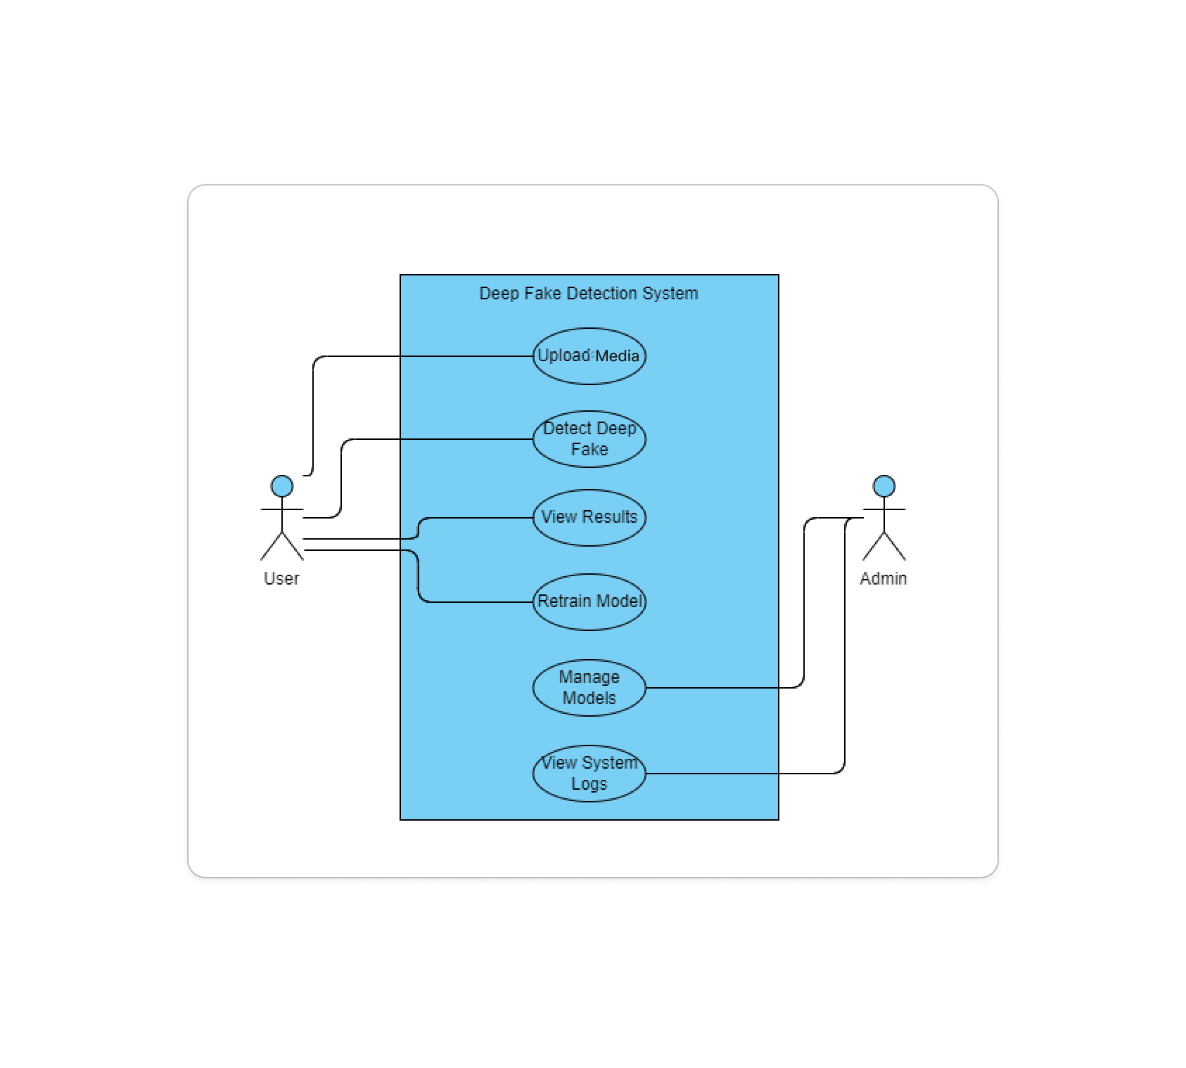
USE CASE DIAGRAM
The diagram shows two key users:
End User – Uploads media to check if it's real or fake.
Administrator – Manages datasets, models, and system logs.
The system allows the End-User to:
Upload Media (Image/Audio/Video)
View Detection Result (Real or Fake)
The Administrator can:
Retrain Model, Access backend code for changes
Simple Interaction Flow
The user interacts with the system through a GUI to perform deepfake checks.
The admin accesses backend tools to update or maintain the system.

Slide 28
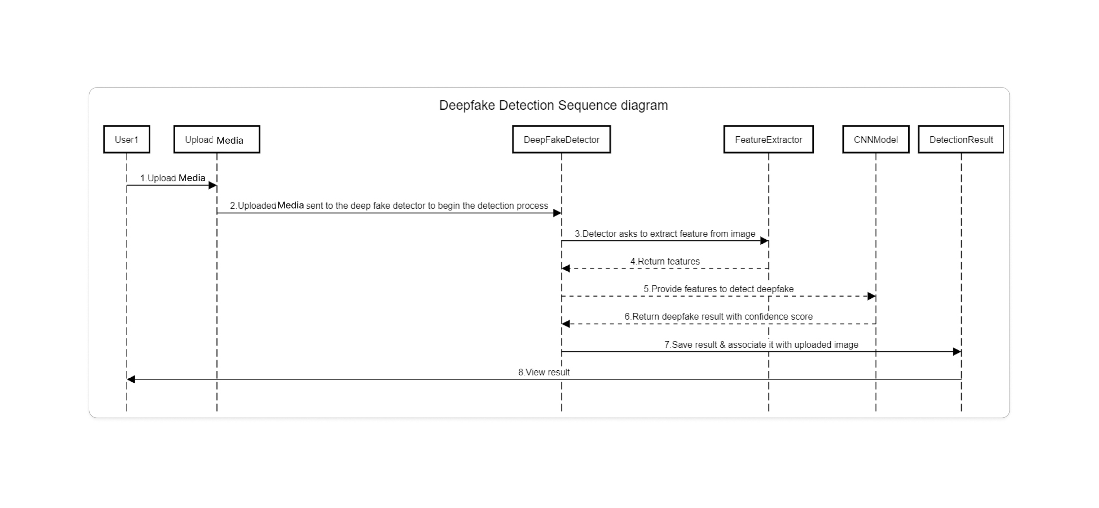

Slide 29
SEQUENCE DIAGRAM
User Uploads Media
The user selects an image, audio, or video file through the system’s GUI.
This request is sent to the controller (main logic handler).
Processing Begins
The controller sends the file to the Preprocessor, which prepares it (resizing, filtering, MFCCs, etc.).
Once ready, the processed media is passed to the Detection Engine.
Prediction Happens
The Detection Engine uses the Deepfake Model to check if the media is real or fake.
The result (e.g., "FAKE", "REAL") is packed into a Prediction Result.
Result Displayed
The Prediction Result travels back to the controller.
The controller shows the final verdict on the screen for the user to see.

Slide 33
SYSTEM REQUIREMENTS
Software Requirements
Operating System: Windows 10 / 11 Programming Language: Python 3.7 or higher
Libraries Used:
OpenCV (image processing)
Librosa (audio feature extraction)
PyQt5 (GUI design)
NumPy, SciPy, TensorFlow/Keras
Hardware Requirements
Processor: Intel i5 or higher
RAM: Minimum 8 GB
Storage: At least 500 MB free space GPU:
NVIDIA GPU with 4–6 GB VRAM (CUDA support) for faster training/inference

Slide 34
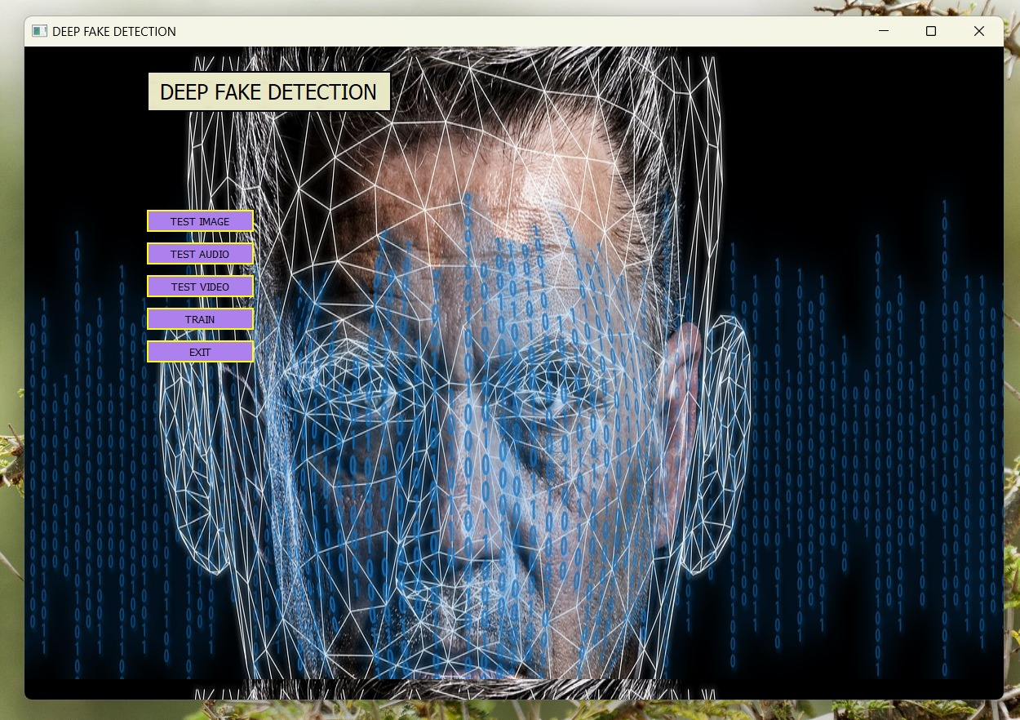

Slide 35
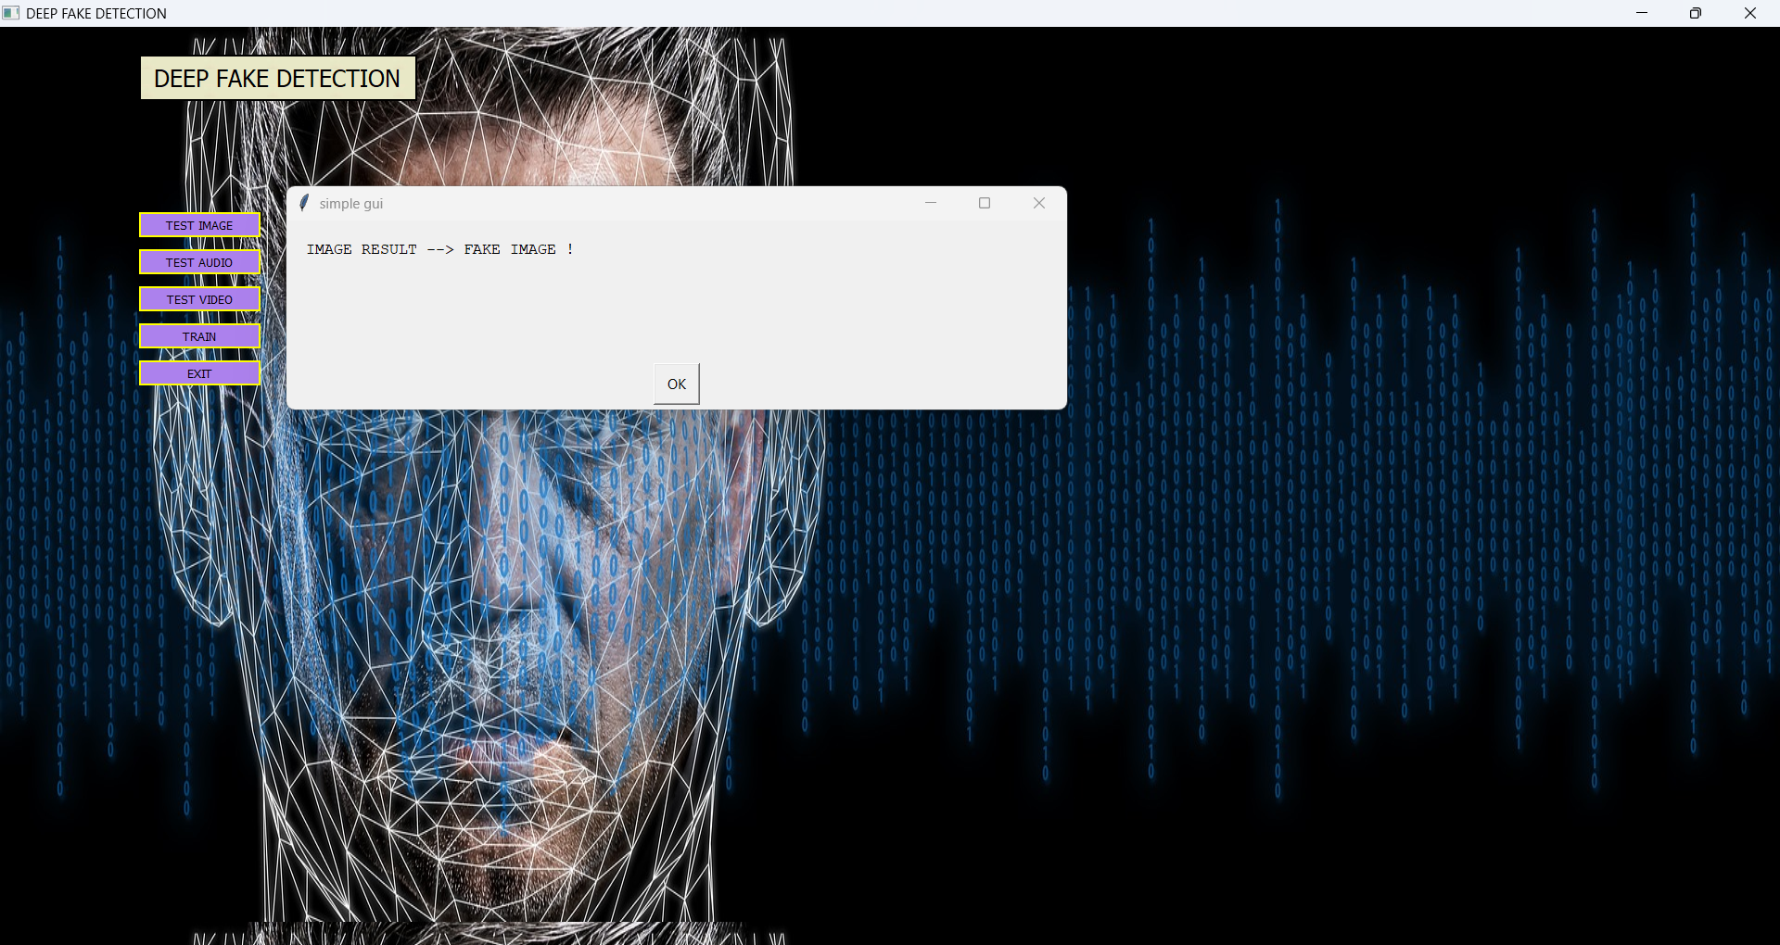
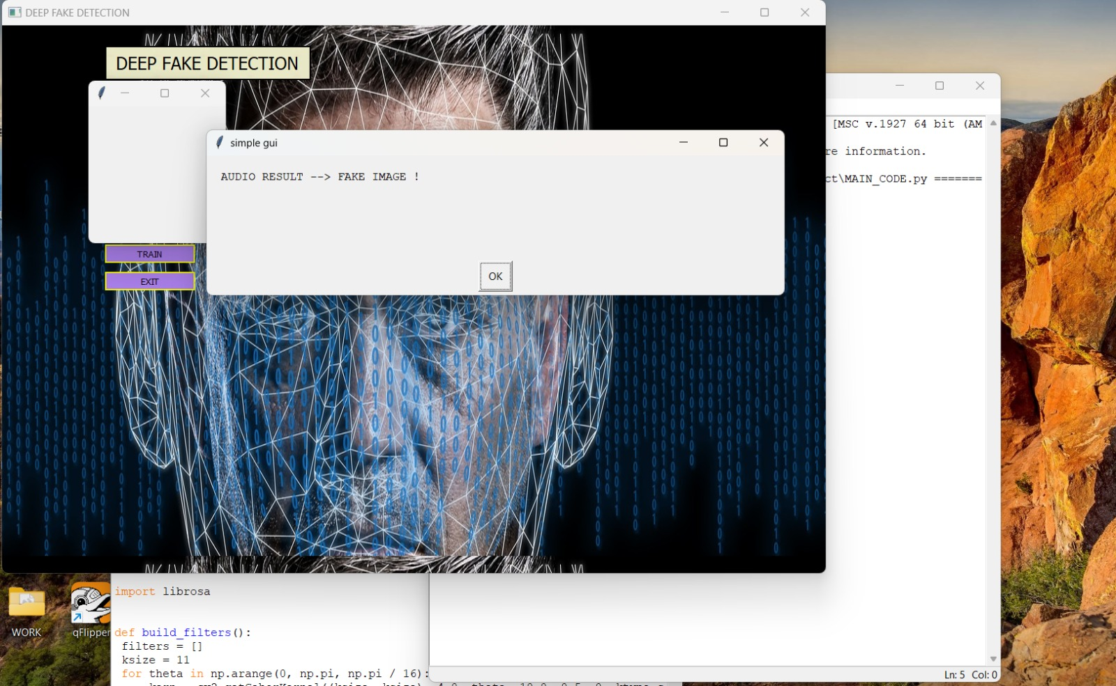

Slide 36
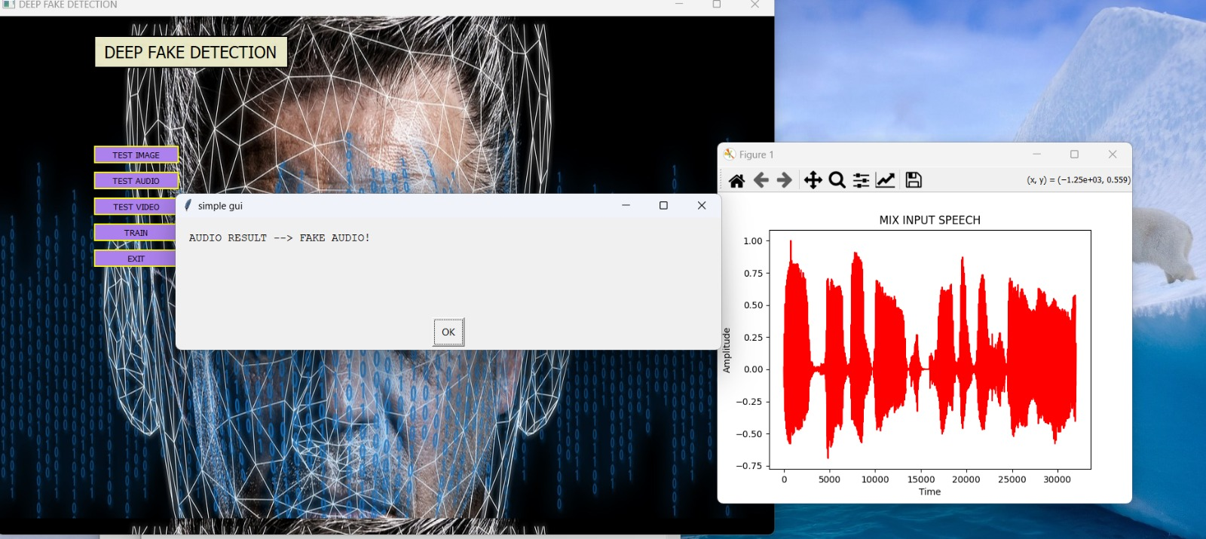

Slide 37
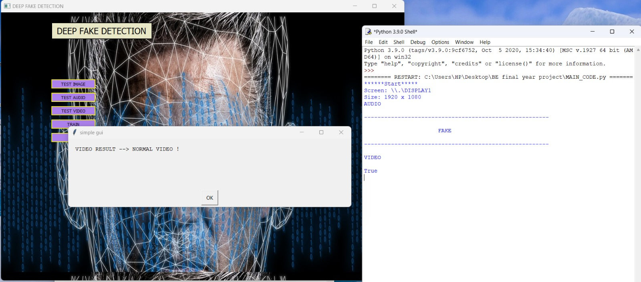

Slide 38
ADVANTAGES AND LIMITATIONS
Advantages :
Multi-Modal Detection:
Detects deepfakes in images, audio, and video — all in one system.
Simple and Fast Algorithm:
Uses lightweight methods (like Gabor filters and MFCC) that work quickly, even without a high-end system.
User-Friendly Interface:
Easy-to-use GUI built with PyQt5, so anyone can test files without coding knowledge.
No Complex Training Needed: Uses nearest-neighbor classification, so it works well even with a small dataset.
Limitations :
Limited Dataset Coverage:
May not detect all new or unseen types of deepfakes if they are very different from the training examples.
Not Fully Automated:
Models must be updated manually when new fake patterns or datasets appear.
No Live Detection:
Currently works only on uploaded files, not on real-time camera or microphone input.
Basic Accuracy Model:
Nearest-neighbor works well for simple cases but may be less accurate than full deep learning models on large-scale data.

Slide 39
REFERENCES
Heidari, A., Jafari Navimipour, N., Dag, H., & Unal, M. (2024). Deepfake Detection Using Deep Learning Methods: A Systematic and Comprehensive Review.[Multimedia Tools and Applications].
Rössler, A., Cozzolino, D., Verdoliva, L., Riess, C., Thies, J., & Nießner, M. (2019). FaceForensics++: Learning to Detect Manipulated Facial Images.ICCV.
Hasanath, A. A., Luqman, H., Katib, R., & Anwar, S. (2024). FSBI: Deepfakes Detection with Frequency Enhanced Self-Blended Images.
Coccomini, D. A., Caldelli, R., Falchi, F., Gennaro, C., & Amato, G. (2022). Cross-Forgery Analysis of Vision Transformers and CNNs for Deepfake Image Detection.ACM MAD Workshop.
Peisong He, Haoliang Li, Hongxia Wang (2024). Detection of Fake Images via the Ensemble of Deep Representations from Multi Color Spaces.
Shad, H. S., Rizvee, M. M., Roza, N. T., Hoq, S. M. A., Khan, M. M., Singh, A., Zaguia, A., & Bourouis, S. (2021). Comparative Analysis of Deepfake Image Detection Method Using CNN.
Jain, A., & Gupta, M. (2020). Deep Fake Detection and Classification using Error Level Analysis.Proceedings of ICIP.
Dong, S., Wang, J., Liang, J., Fan, H., & Ji, R. (2021). Explaining Deepfake Detection by Analyzing Image Matching.MEGVII Technology.
Masood, S., Mehmood, R., Shafi, K., & Khan, Z. (2021). Deepfakes Generation and Detection: State-of-the-art, Open Challenges, Countermeasures, and Way Forward. arXiv preprint arXiv:2103.00484.
Nguyen, H. T., & Nguyen, T. M. (2023). Multi-modal Deepfake Detection with Hybrid Convolutional Recurrent Neural Networks.International Journal of Computer Vision.
Li, Y., Yang, H., Wu, X., & Zhai, Y. (2022). DeepFake Detection Using Transfer Learning and Attention Mechanisms. Journal of Visual Communication and Image Representation, 83, 103441.
Jain, A., Gupta, M., & Sal, A. (2021). Exploring the Robustness of Vision Transformers for Deepfake Detection.ICCV.
Speech Foundation Model Ensembles for Singing Voice Deepfake Detection (2024). CtrSVDD Dataset Performance Analysis using Squeeze-and-Excitation Aggregation (SEA).
DF40 Team (2024). Toward Next-Generation Deep Fake Detection Using DF40 Benchmark.
GAN & Diffusion Model Team (2023). Mastering Deep Fake Detection: Distinguishing GAN and Diffusion-generated Images Using AUC & F1

Slide 40

Thank you
Presented By :
Group No. 6
1. Aditya Chavan Exam No. B400360548
2. Varad Dixit Exam No. B400360575
3. Saidutt Bhagat Exam No. B400360517
4. Pranav Dumbre Exam No. B400360580

